Slide 1
Individual and Community Benefits to Providing Expedited Partner Therapy: Policy Perspective
Stephanie S. Arnold Pang
Senior Director,
Policy and Government Relations

Slide 2
CHAT
CHAT IN -- Where are you/your agency located? (state, type of organization, urban or rural?)

Slide 3
Disclosure
Disclosure: Stephanie Arnold Pang has no financial interest to disclose.

Slide 4
Goals of Presentation
State of STIs
Overview of EPT
Discuss Policy Success and Barriers

Slide 5

NCSD Mission & Vision
MISSION
To advance effective STI prevention programs and services in every community across the country. NCSD does this as the voice of our membership. We provide leadership, build capacity, convene partners, and advocate.
VISION
A nation without sexually transmitted diseases.
Revisiting our mission & vision:
Moving towards a sexual health & wellbeing framework, and away from a disease model.

Slide 6

What We Do
Capacity Building​
Policy & Advocacy​
National Leadership & Strategic Communications
Promoting Health Equity​
Organizational Strengthening

Slide 7
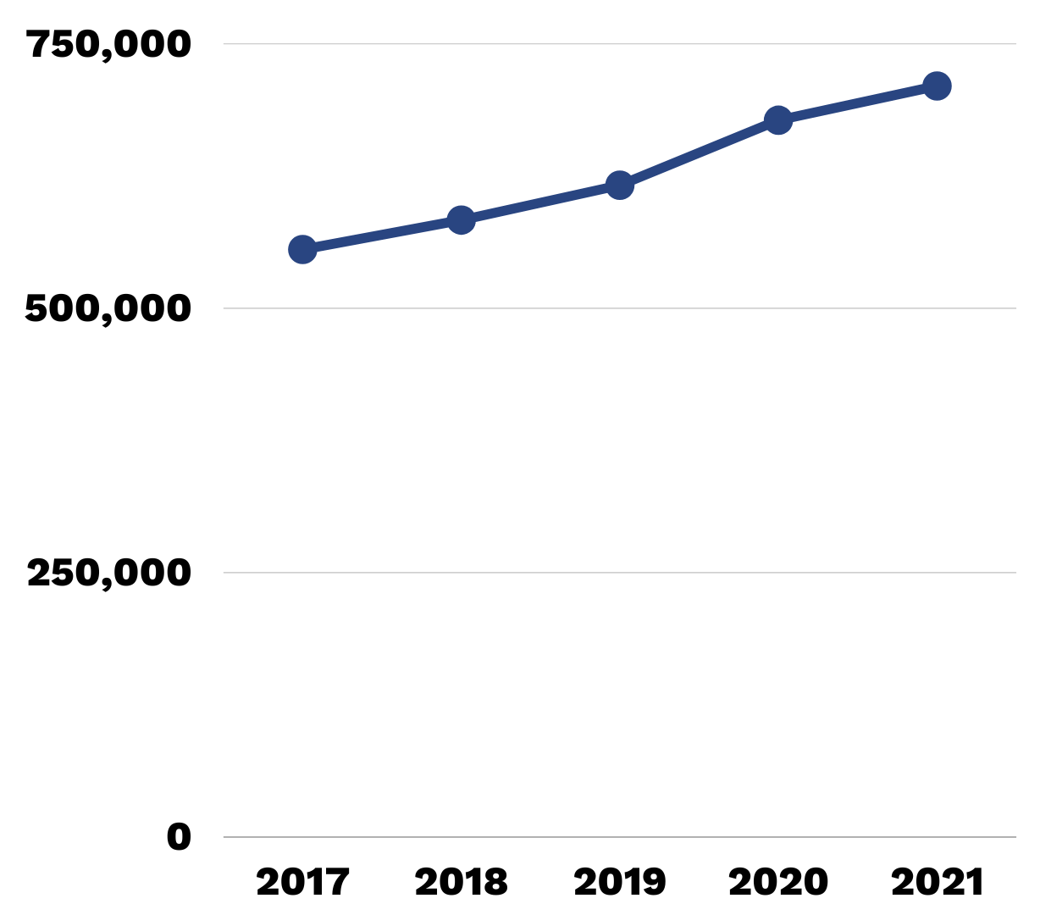
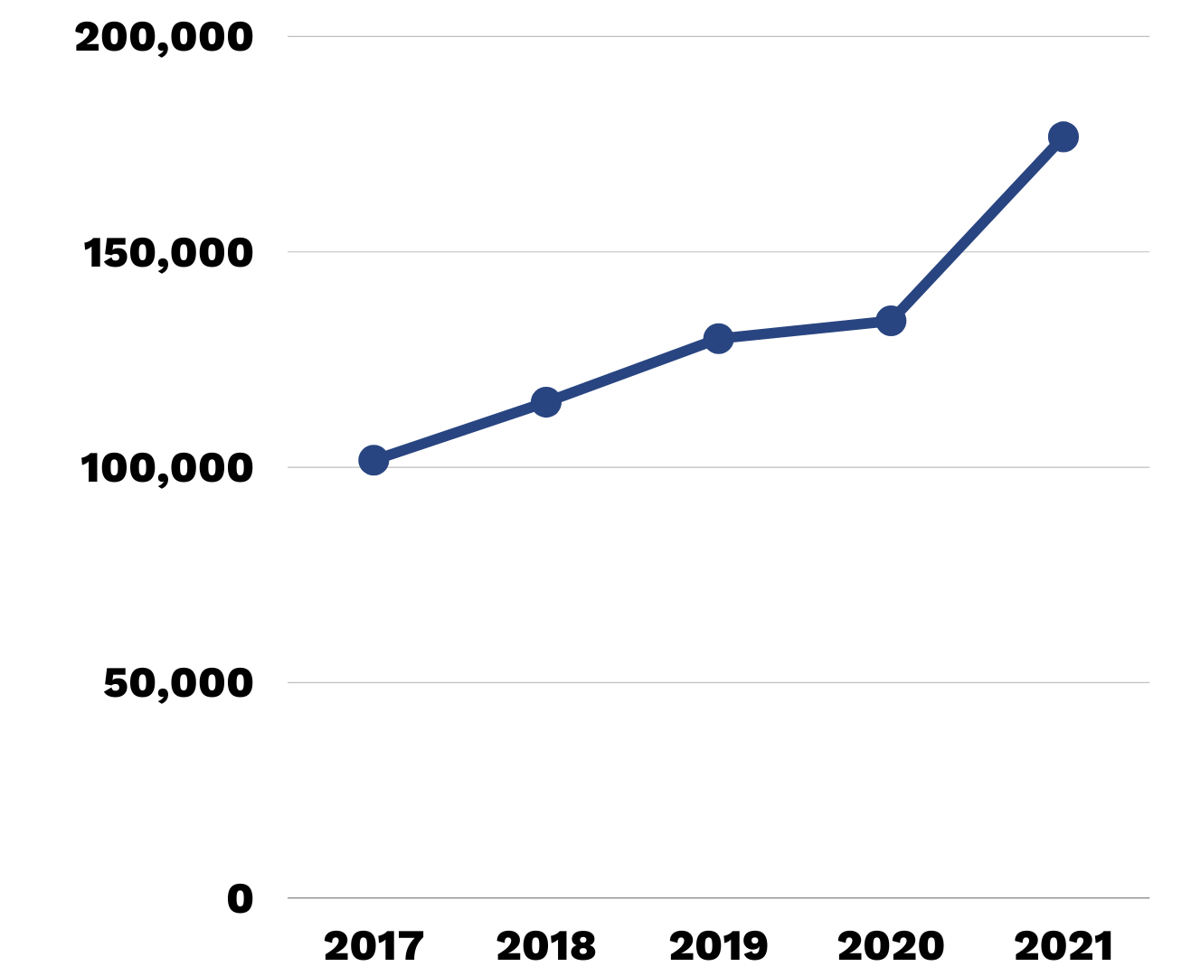
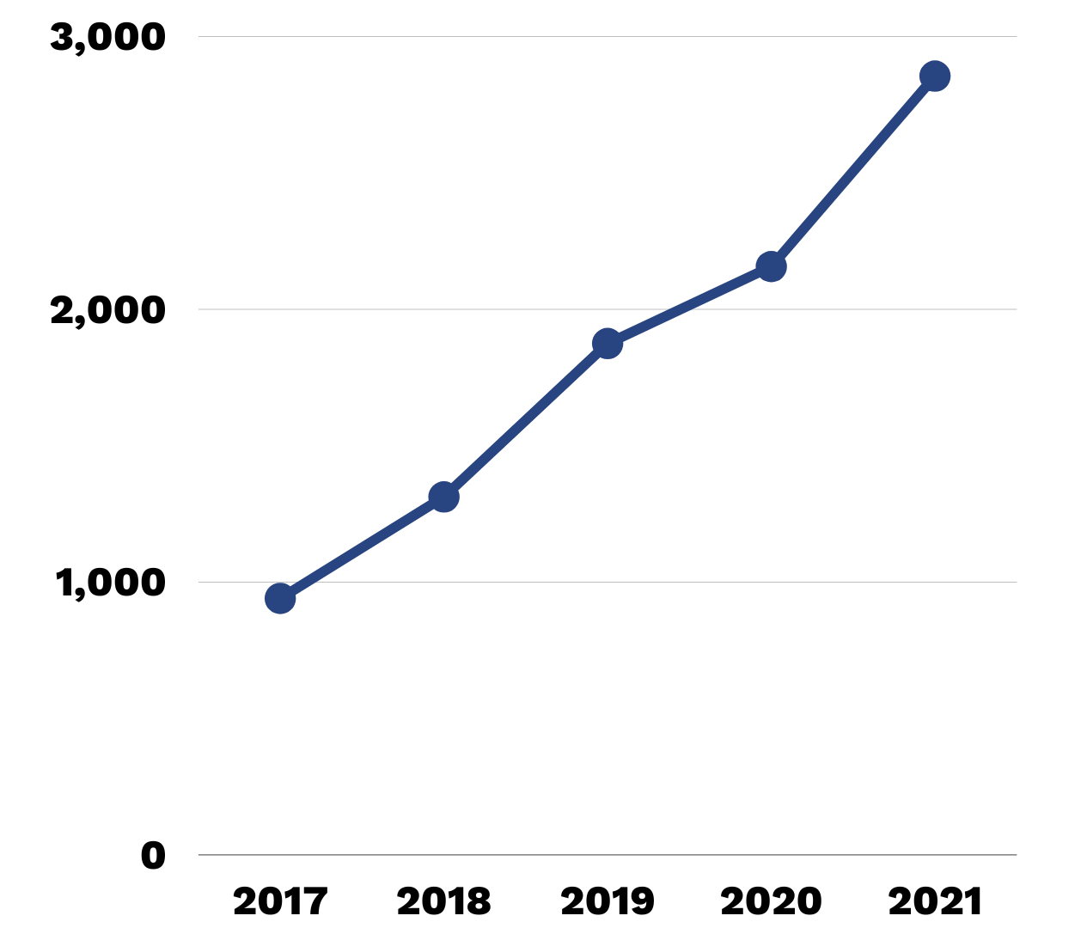
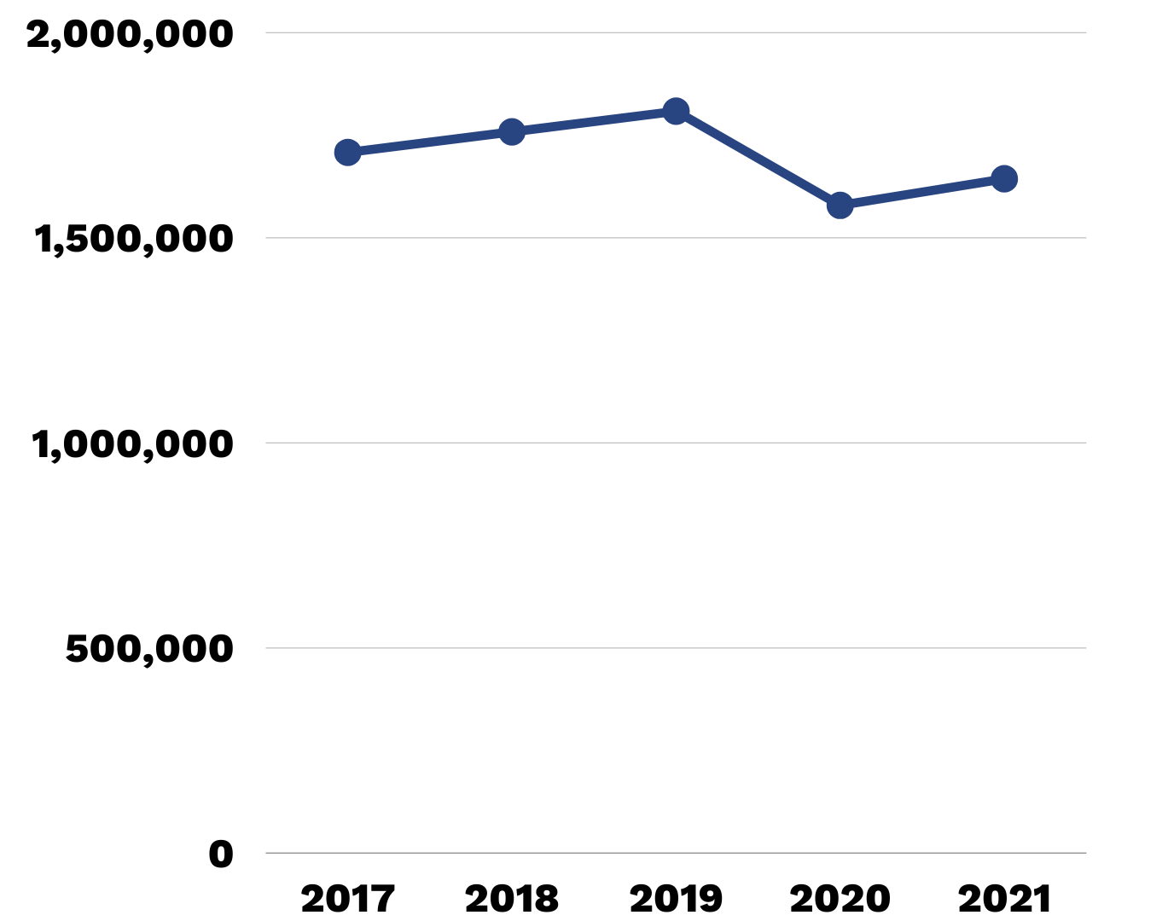
Why We Do It
Chlamydia​
Gonorrhea
Syphilis
Congenital Syphilis​
https://www.cdc.gov/std/statistics/2021/default.htm, accessed May 1, 2023

Slide 8
Current state of STIs

Slide 9
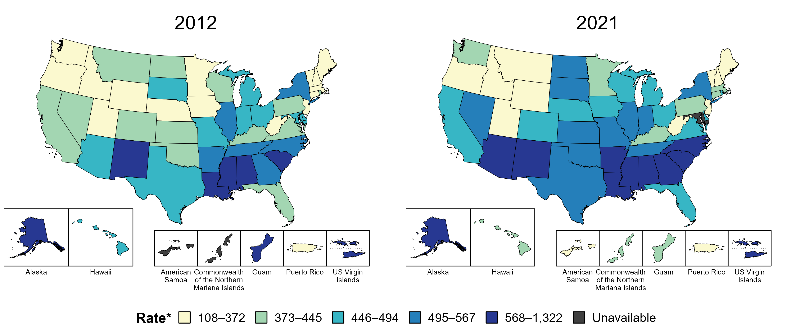
Chlamydia — Rates of Reported Cases by State, United States and Territories, 2012 and 2021
* Per 100,000
Notes:
In 2012, 12 states, the District of Columbia (DC), and two US territories (27.8% of areas with available data) had a rate of reported chlamydia greater than or equal to 495 cases per 100,000 population. This increased to 21 states, DC, and one US territory (41.8% of areas with available data) in 2021.
American Samoa and the Commonwealth of the Northern Mariana Islands began reporting data on chlamydia cases to CDC in 2018; data are not available for those areas prior to that year. Due to a network security incident in December 2021, the Maryland Department of Health could not finalize their 2021 STD case notification data. 2021 data from Maryland have been suppressed for this figure; however, they are included in national and regional case counts and rates displayed in other figures.
The COVID-19 pandemic has introduced uncertainty and difficulty in interpreting STD data collected during 2020 and 2021. See Impact of COVID-19 on STDs (https://www.cdc.gov/std/statistics/2021/impact.htm) for more information.
See Technical Notes (https://www.cdc.gov/std/statistics/2021/technical-notes.htm) for information on chlamydia case reporting and on interpreting reported rates in US territories.
Data points are available at https://www.cdc.gov/std/statistics/2021/data.zip.

Slide 10
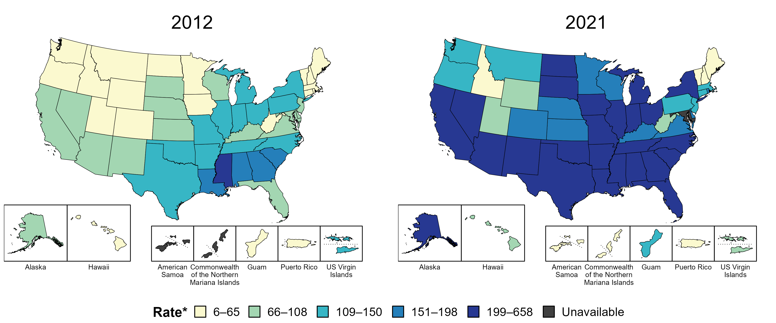
Gonorrhea — Rates of Reported Cases by State, United States and Territories, 2012 and 2021
* Per 100,000
Notes:
In 2012, five states and the District of Columbia (DC; 11.1% of areas with available data) had a rate of reported gonorrhea greater than or equal to 151 cases per 100,000 population. This increased to 34 states and DC (63.6% of areas with available data) in 2021.
American Samoa and the Commonwealth of the Northern Mariana Islands began reporting data on gonorrhea cases to CDC in 2018; data are not available for those areas prior to that year. Due to a network security incident in December 2021, the Maryland Department of Health could not finalize their 2021 STD case notification data. 2021 data from Maryland have been suppressed for this figure; however, they are included in national and regional case counts and rates displayed in other figures.
The COVID-19 pandemic has introduced uncertainty and difficulty in interpreting STD data collected during 2020 and 2021. See Impact of COVID-19 on STDs (https://www.cdc.gov/std/statistics/2021/impact.htm) for more information.
See Technical Notes (https://www.cdc.gov/std/statistics/2021/technical-notes.htm) for information on gonorrhea case reporting and on interpreting reported rates in US territories.
Data points are available at https://www.cdc.gov/std/statistics/2021/data.zip.

Slide 11
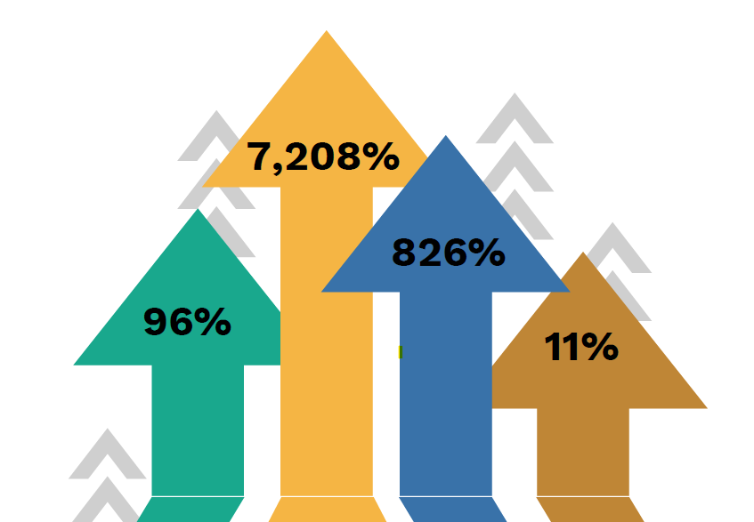
Missouri Stats
In 2021 alone:​
49,798 STI diagnoses​.
MO ranked 13th in the US for chlamydia diagnoses among young people (13-24)​.
48% of the state's gonorrhea cases were among Black people (who are 12% of the population).
From 2012 to 2021 in MO:
CS rates up 7,208%
Syphilis rates up 826%
Gonorrhea rates up 96%
Chlamydia rates up 11%

Slide 12
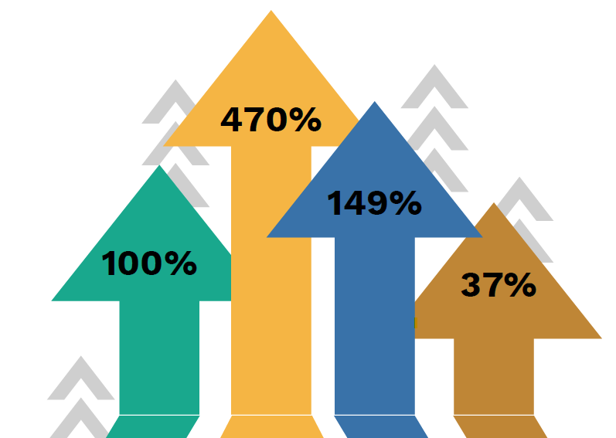
Kansas Stats
In 2021 alone:​
21,044 STI diagnoses​.
KS ranked 20th in the US for chlamydia diagnoses among young people (13-24)​.
30% of the state's gonorrhea cases were among Black people (who are 6% of the population).
From 2012 to 2021 in KS:
Syphilis rates up 470%
Gonorrhea rates up 149%
CS rates up 100%
Chlamydia rates up 37%

Slide 13
Why STD Prevention is Important
Nearly $16 billion in direct medical costs every year
Higher risk of HIV infection
Higher risk of certain cancers
STDs in Pregnancy: fetal death, disabilities, prematurity
Women are particularly vulnerable to STDs and their consequences
  Infertility
  Ectopic Pregnancy
  Pregnancy loss and still birth

Slide 14
Tools for STD Prevention
Primary prevention
  Behavior change
Primary and secondary prevention
  Case-finding & treatment
Increase screening
Rescreening
Improve partner treatment

Slide 15
Role of Public Health
Partner notification and contact tracing key underpinning of public STD programs
Disease Intervention Specialists (DIS) interview people with an STD
Receives contact information, attempts to contact those partners
Goal: Partners are tested and treated

Slide 16
DIS for Every STD??
Public health does not have resources to follow-up on all STD cases
Private sector health challenges as well
Due to financial and personnel constraints, STD programs often focus on only syphilis and HIV
A new option for the treatment of partners is needed

Slide 17


Slide 18
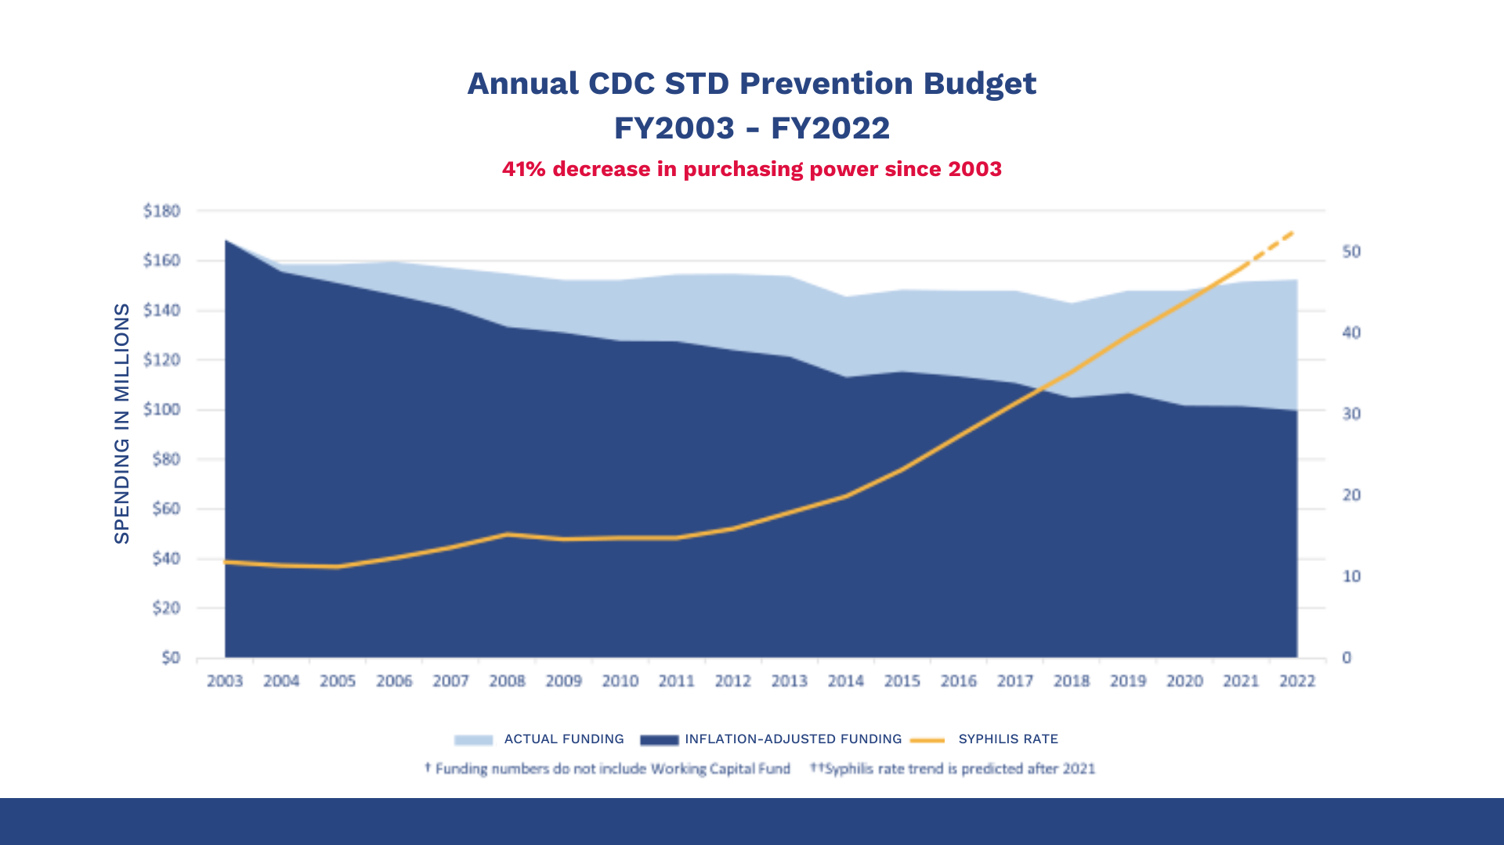

Slide 19
ENTER…Expedited Partner Therapy

Slide 20
Poll
Do you/your organization provide expedited partner therapy now?
YES
NO

Slide 21
What is Expedited Partner Therapy?
Harm reduction strategy of treating the sex partners of persons with STIs chlamydia and gonorrhea without an intervening medical evaluation
EPT allows health care professional to provide patients with antibiotics or prescriptions for their partners without requiring a visit by that partner
Treatment of the partner is critical to preventing reinfection, reducing STI rates

Slide 22
Poll
If you DO provide expedited partner therapy, for which STIs do you provide medications? (check all that apply)
Chlamydia
Gonorrhea
Trichomoniasis
Other

Slide 23
Poll
If you DO provide expedited partner therapy, which mechanism of distribution/administration is the most common?
Dispense at clinic to index patient to deliver to partners
Provide prescriptions to index patient for partners
Provide prescriptions for more than one dose of medication to index patient so they can deliver to their partners
Make phone or telehealth contact with partners and provide medication after consultation with partners
Other

Slide 24
Organizations that Support EPT
Centers for Disease Control and Prevention
American Academy of Family Physicians
American Bar Assoc.
American College Health Assoc.
American College of Obstetricians and Gynecologists
American Osteopathic Association
Council of State Governments
Natl Assoc. of County and City Health Officials
National Coalition of STD Directors
Society for Adolescent Health and Medicine

Slide 25
CDC EPT Map
https://www.cdc.gov/std/ept/default.htm
www.cdc.gov/std/ept/legal/legaltoolkit.htm
“The Legal Aspects of EPT Practice: Do State Laws and Polices Really Matter?”
Notes:
Discuss what “potentially allowable” means
Legal aspect article– discuss top line message
Even after EPT laws passed, continued to be refined– adding trich,

Slide 26
Poll
If you DO NOT currently provide EPT, are there plans in place for you/your organization to provide expedited partner therapy in the future?
YES
NO

Slide 27
Poll
If you/your agency plan to provide expedited partner therapy in the future, for which STIs will you provide medications? (check all that apply)
Chlamydia
Gonorrhea
Trichomoniasis
Other

Slide 28
Poll
If you plan to provide expedited partner therapy in the future, by what mechanisms will you provide the medications?
Dispense to index patient to deliver to partners
Provide prescriptions to index patient to deliver to partners
Other

Slide 29
CHAT
If your agency DOES NOT currently provide EPT -- CHAT IN – what are the primary barriers?

Slide 30
Barriers to EPT
Lack of awareness/provider buy-in
Cost/access to medication
Concerns regarding gonorrhea resistance
Concerns regarding drug allergies
Notes:
CDC Treatment Guidelines: “Because EPT must be an oral regimen and current gonorrhea treatment involves an injection, EPT for gonorrhea should be offered to partners unlikely to access timely evaluation after linkage is explored.”

Slide 31
CHAT
If you/your agency currently provides EPT – CHAT IN – what are/were the facilitators that made it happen?

Slide 32
Mitigating EPT Barriers
Frequent provider education, resources
Patient Materials
Provide EPT packs
340B, Medicaid/ FP waiver reimbursement
EPT Subcommittees, Community Engagement
Notes:
Michigan success story– packs for Eds

Slide 33

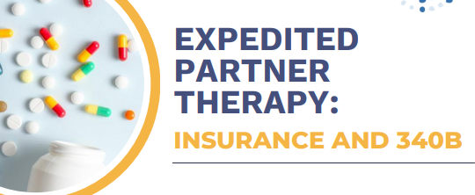
Mitigating Barriers– NCSD Resource!
https://www.ncsddc.org/resource/expedited-partner-therapy

Slide 34
Stephanie S. Arnold Pang sarnold@ncsddc.org www.ncsddc.org

