Slide 1
Expedited Partner Therapy
Joseph Cherabie MD (he/they)
Assistant Professor, Division of Infectious Diseases, Washington University St. Louis
PI Wash U CBA
Medical Director St. Louis PTC
Medical Director WashU PrEP Clinic
@JncherabieMD

Slide 2
Disclosures
No relevant disclosures

Slide 3
What is Expedited Partner Therapy?
Allows for empirically providing antibiotics to the partners of index cases of patients with gonorrhea and chlamydia without establishing a therapeutic relationship.
Unfortunately, oral therapy for gonorrhea is an alternative therapy---so EPT for gonorrhea has challenges.

Slide 4
2021 Uncomplicated GC Treatment
PREFERRED: Weight <150 kg → Ceftriaxone 500 mg IM x 1 Weight ≥150 kg → Ceftriaxone 1 gram IM x 1
CHLAMYDIA CO-INFECTION PRESENT OR NOT EXCLUDED: Not Pregnant → Doxycycline 100 mg PO BID x 7 days Pregnant or not excluded → Azithromycin 1 gram PO x 1

Slide 5
2021 Uncomplicated Chlamydia Treatment
Preferred in patients who are not pregnant Doxycycline 100 mg orally twice daily for 7 days
Alternatives (but not for rectal chlamydia) Azithromycin 1 g orally once* (consider evaluation/testing at 4 weeks for rectal CT) Levofloxacin 500 mg orally for 7 days
*Preferred during pregnancy

Slide 6
Randomized placebo-controlled trial
177 participants enrolled, 135 (76%) met CC population
7-day course of doxycycline was significantly more effective than a single dose of azithromycin
Source: Dombrowski et al, CID 2021
Notes:
This randomized, double-blind, placebo-controlled trial compared azithromycin (single 1-g dose) versus doxycycline (100 mg twice daily for 7 days) for the treatment of rectal CT in men who have sex with men (MSM) in Seattle and Boston.

Slide 7
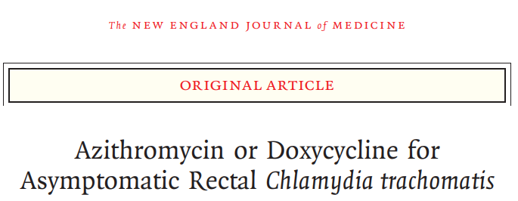
625 cisgender men with asymptomatic rectal chlamydia.

Slide 8
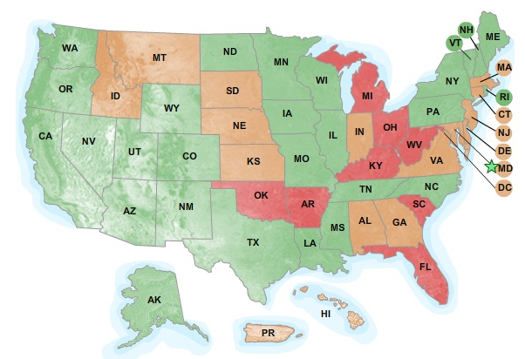
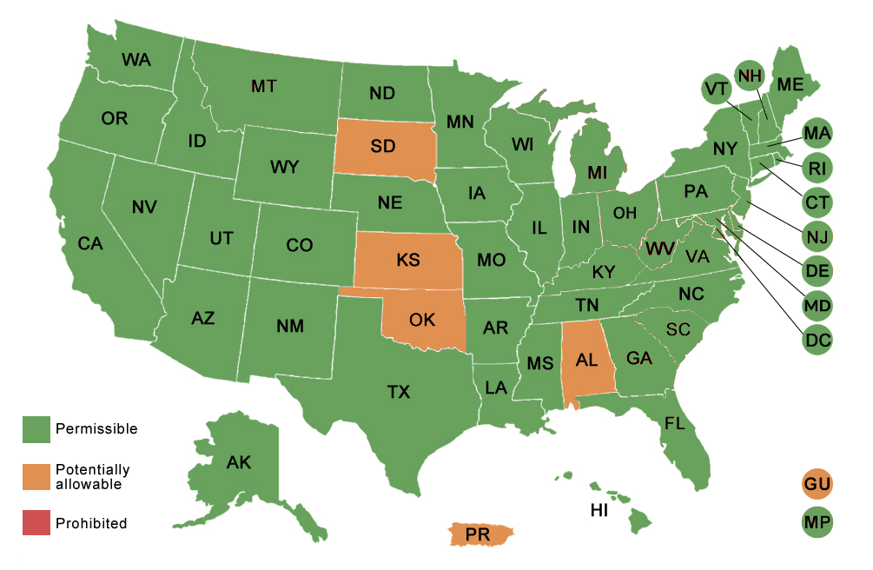
Legal Status of EPT
2011
2021
GREEN STATES: EPT is permissible (N=28)
YELLOW STATES: potentially allowable (N=14)
RED STATES: prohibited (N=8)
permissible (N=46)
potentially allowable (N=4)
prohibited (N=0)

Slide 9
Evidence for EPT
Studies of effectiveness have used azithromycin for chlamydia EPT and pre-packaged medications [Schillinger et al 2003, Golden et al 2005, Kissinger et al 2005].
A 2013 meta-analysis found:
“moderate-quality evidence that expedited partner therapy is better than simple patient referral for preventing re-infection of index patients when combining trials of STIs that caused urethritis or cervicitis
(6 trials; RR 0.71, 95% CI 0.56 to 0.89, I(2) = 39%). ”
Chlamydia reduced by 20% and gonorrhea by 50% on follow up testing.
DO health departments provide EPT?
LHDs: 66.8% for chlamydia; 39.3% for gonorrhea (Cuffe et al. 2021. STD 48(6): 429.)

Slide 10
EPT Evidence
Four RCTs:
1800 women for CT: Recurrent infection found in 12% that had EPT vs 15% with partner referral (OR 0.8, CI 0.62-1.05)
2700 men and women with GC or CT: Recurrent infection in 9.9% EPT vs 13% other (OR 0.76)
977 men with GC or CT: 23% EPT, vs 37.5% other
463 women with Trich: no difference
Trials showed reduced rates of sex with untreated partners.

Slide 11
EPT for MSM
2021 STI Treatment Guidelines: For cisgender men who have sex with cisgender men, shared decision making is recommended.

Slide 12
EPT, behavior, and costs
Patients notify partners at high rates.
Costs are higher for patient delivered partner treatment but cost-saving with averted pact of STIs.
For adolescents, multi site trial showed no difference with ½ of the patients from 14-19 years.

Slide 13
Used an EPT prescription voucher program to track medication pickup.
Operated in multiple states.
Of 900 vouchers, 41% were redeemed. For one location with an on site pharmacy, 76% were redeemed.
Women and those > 18 were more likely to redeem vouchers.

Slide 14
EPT dosing
Chlamydia
Doxycycline 100 mg PO BID x 7 d
OR
Azithromycin 1g PO x 1 dose
Gonorrhea
Cefixime 800 mg PO x 1 dose

Slide 15
EPT for trichomonas: Did not result in partners taking the meds or lower rates of re-infection than partner referral.

Slide 16
Supports use of EPT
Must assess for risk of intimate partner violence

Slide 17
EPT Limitations
No evidence that EPT for Trich is successful
Limited evidence of effectiveness in MSM – 5% HIV coinfection (need evaluation) – EPT through shared decision making
How can you do it?
Prescribe in partner’s name in some states.
Send them to clinic if you have a partnership.
Call prescription into the pharmacy in partner’s name and document in patient’s chart.

Slide 18
EPT Implementation at WashU ID Clinic
Collaboration with in-house pharmacy
Used 340B funds to make no cost for patient
Developed workflow
Distributed amongst clinicians, staff nurses, and APPs

Slide 19
Patient diagnosed with NG, CT through diagnostic testing or clinical examination
Clinician assesses for number of sexual partners in last 3 months and possible EPT
If EPT desired by patient, clinician e-prescribes treatment for patient in clinic and calls up to pharmacy for EPT, put EPT in pharmacist notes
Patient delivers EPT to partners
Pharmacist discusses possible side effects, allergies, and informs patient of informational packets for respective dx in each EPT pack
Pharmacy fills prescription for patient and obtains up to 3 EPT packets for patient’s partners from EPT storage (in Pharmacy Manager’s office)
Information in each packet includes list of allergies, information on PID (for partners with cervix/uterus), side effects from drugs, prescription instructions, and disease information for NG and CT, with instructions for abstinence 10 days after treatment and info on when to seek medical advice
CT- Azithromycin 1g PO once (especially if cannot r/o pregnancy) or Doxycycline 100mg PO BID 7 days (especially if risk for rectal infection)
NG- Cefexime 800mg PO once (+ azithromycin 1g PO once if CT has not been r/o in patient)

Slide 20
Issues faced with implementation
Hesitancy by providers with respect to complications and allergies
Lack of proper sexual history taking (past partners in last 3 months)
Some pharmacies refuse to fill prescriptions if they do not have patient name
Hesitancy of pharmacies to fill medication for multiple day course instead of one time dose (interpretation of law in some states)
Lack of means to contact partners (dating apps, past relationships)
Can use notifymypartner.com
Preference for partner test and treat
EPT for Trich?

